Slide 1


Zina Mahefarivo RAKOTOMAVONJATOVO
12/04/2024

Slide 2

Outline
Executive Summary
Introduction
Methodology
Results
Conclusion
Appendix

Slide 3
Executive Summary
Summary of methodologies
- Data collection using API and Web Scraping
- Data Wrangling
- Exploratory Data Analysis using SQL and visualization
- Interactive Visual Analytics
- Dashboarding
- Predictive analytics
Summary of all results
- Identify the key features that affect the result of the launch
- An interactive dashboard for real-time analysis has been developed
- Produce a model capable of predicting the outcome of rocket launch with an accuracy of 83.8%

Slide 4
Introduction
Project background and context
SpaceX advertises Falcon 9 rocket launches at a cost of 62 million dollars, compared to 165 million dollars for other providers
This cost saving is essentially due to the fact that SpaceX reuses its rocket first stage
Being able to predict the likelihood of a successful landing gives the advantage, to an alternate company, to estimate more precisely the launch costs, and apply a better bid strategies when competing against SpaceX
And this is the aim of this analysis
Problems you want to find answers
What are the factors that determine the successful landing of a rocket?
Can we predict the likelihood of a successful landing?
What is the maximum accuracy of the prediction?

Slide 5

Section 1

Slide 6
Methodology
Executive Summary
Data collection methodology:
Calling SpaceX REST API
Web Scraping on Wikipedia pages
Perform data wrangling
Data Inspection, Data Cleaning, Encoding Categorical values, Data Normalization
Perform exploratory data analysis (EDA) using visualization and SQL
Perform interactive visual analytics using Folium and Plotly Dash
Perform predictive analysis using classification models
Models from Scikit-Learn library
Find best parameters using GridSearchCV

Slide 7
Data Collection
We have 2 different data sources involving 2 different methods:
SpaceX REST API
- Call the API using requests object
- Parse the JSON response to Pandas DataFrame
Web Scraping
- BeautifulSoup is used to extract data from Wikipedia web page
- SpaceX launch records contained in HTML Table are parsed and converted to Pandas DataFrame

Slide 8
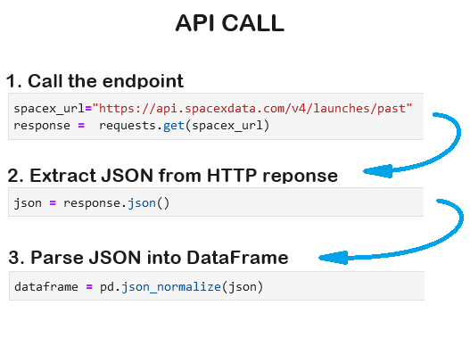
Data Collection – SpaceX API
Need to call multiple endpoints to get the whole data set
Start requesting rocket launch historical data
From launchpad , request for launch site name and location
From payloads , request for payload weight and orbit
From cores , request for rocket details
Compile all into a single DataFrame
Link to notebook: https://github.com/zina-mahefarivo/spacex-capstone-project/blob/main/1_jupyter-labs-spacex-data-collection-api.ipynb

Slide 9
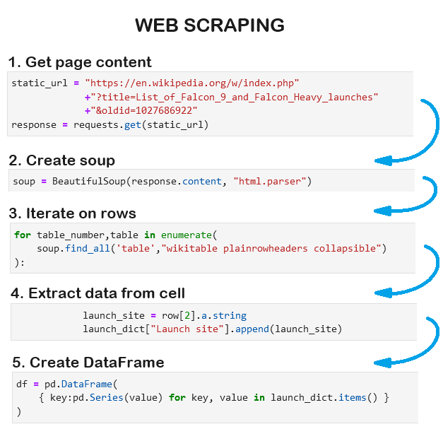
Data Collection - Scraping
Obtain page content by using HTTP get
Create BeautifulSoup object from HTML page
Select Launch HTML table
Iterate on rows
Extract data from each cell
Create DataFrame from all result lists
Link to notebook: https://github.com/zina-mahefarivo/spacex-capstone-project/blob/main/2_jupyter-labs-webscraping.ipynb

Slide 10
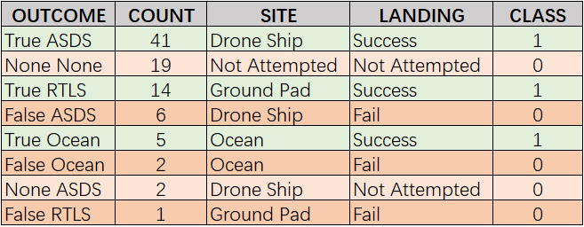
Data Wrangling
Clean data
Identify missing values
Replace missing PayloadMass by mean value
Ensure Data Consistency
- Check data types
Explore Data
- Nb of launches per site
- Nb of occurence of each orbit
- Nb of occurence of outcome
Transform Data
- From Outcome, extract/encode the Class of the launch
Link to notebook: https://github.com/zina-mahefarivo/spacex-capstone-project/blob/main/3_labs-jupyter-spacex-Data%20wrangling.ipynb

Slide 11
EDA with Data Visualization
Plotted Charts
Flight Number VS Launch Site: To verify the pattern between the 2 variables and the outcome
Payload VS Launch Site: To visualize which site launch heavy payload
Orbit VS Success Rate: To identify which orbits have high landing success rate
Orbit VS Flight Number: To check the relationship between Flight Nb and orbit
Orbit VS Payload: To verify to which orbit heavy/light payloads are sent
Year VS Success Rate: To emphasize from which year success rate started to increase
Link to notebook: https://github.com/zina-mahefarivo/spacex-capstone-project/blob/main/4-jupyter-lab-data-visualization.ipynb

Slide 12
EDA with SQL
List of unique launch sites in the space mission
List 5 records where launch sites begin with ‘CCA’
Total payload mass carried by boosters launched by NASA (CRS)
Average payload mass carried by booster version F9 v1.1
Date of first successful landing on ground pad
Boosters with payload between 4000 and 6000 kg that successfully landed on drone ship
Total number of successful and failure mission outcomes
Names of boosters that carried the maximum payload mass
Count of landing outcomes between 2 dates in descending order
Link to notebook: https://github.com/zina-mahefarivo/spacex-capstone-project/blob/main/5_jupyter-lab-eda-with-sql.ipynb

Slide 13
Build an Interactive Map with Folium
Circle - Used to indicate a launch site
Marker - Combined with a Circle, is used to indicate a launch site
Marker - Also used to indicate the outcome of each launch in each site
MarkerCluster - Used to display a constellation of Markers
MousePosition - Indicates the latitude and longitude of the mouse pointer
Line - Used to indicate distance
Link to notebook: https://github.com/zina-mahefarivo/spacex-capstone-project/blob/main/6_jupyter-lab_launch-site-location.ipynb

Slide 14
Build a Dashboard with Plotly Dash
INPUTS
Drop-down list - Allows to select different launch sites
Range slider - Allows to select a range of payload weight
CHARTS
Pie chart - Shows the proportion of success landing for all or the selected site
Scatter plot - Displays the correlation between the Payload and the Outcome
Link to notebook: https://github.com/zina-mahefarivo/spacex-capstone-project/blob/main/spacex_dash_app.py

Slide 15
Predictive Analysis (Classification)
Algorithms: Logistic Regression, SVM, Decision Tree, KNN
Use GridSearchCV object to find the best parameters
Display confusion matrix
Calculate accuracy on training and test sets
Compare scores to identify the best model
Link to notebook: https://github.com/zina-mahefarivo/spacex-capstone-project/blob/main/7_jupyter-lab_SpaceX_Machine_Learning_Prediction.ipynb

Slide 16
Results
Exploratory data analysis results
Interactive analytics demo in screenshots
Predictive analysis results

Slide 17

Section 2

Slide 18
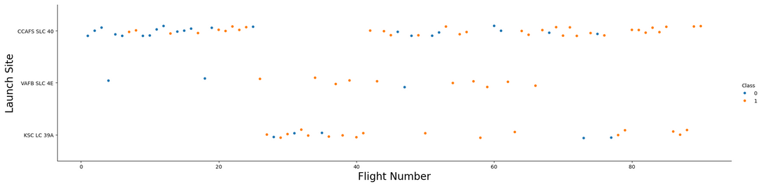
Flight Number vs. Launch Site
Insights:
There are more successful landing starting from Flight Number 25
With more attempts, we have more successful outcome

Slide 19
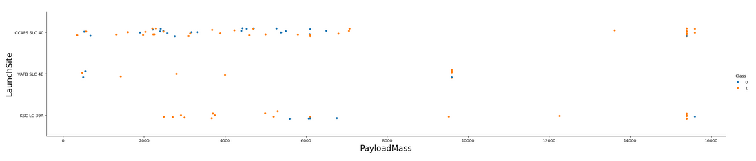
Payload vs. Launch Site
Insights:
No heavy launches has been sent from VAFB SLC 4E
There are more failed landing attempts on CCAFS SLC 40 than on other sites

Slide 20
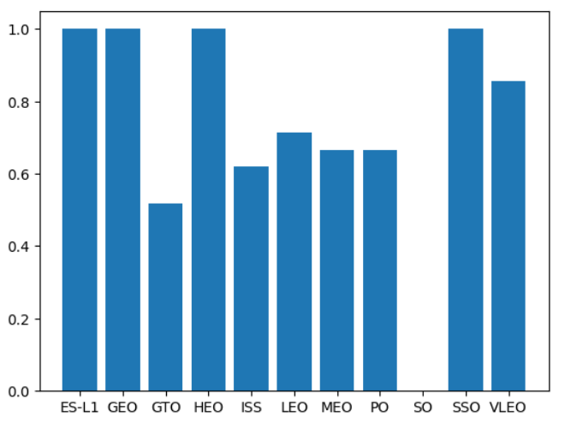
Success Rate vs. Orbit Type
Insights:
Rockets sent to ES-L1, GEO, HEO, SSO and VLEO have high success rate
No rockets sent to SO have landed successfully

Slide 21
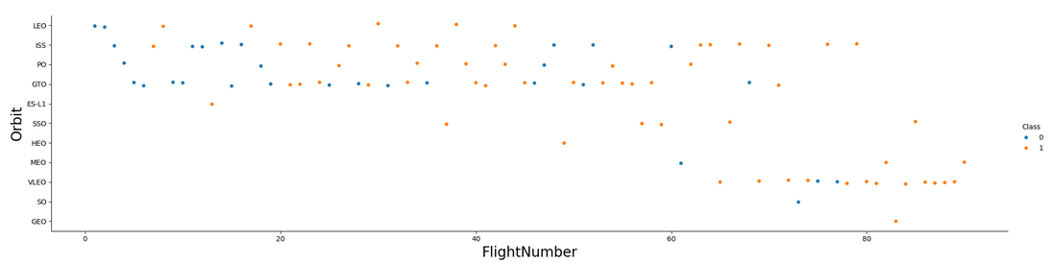
Flight Number vs. Orbit Type
Insights:
For LEO orbit, the outcome appears related to the Flight Number
No rockets sent to SO have landed successfully

Slide 22
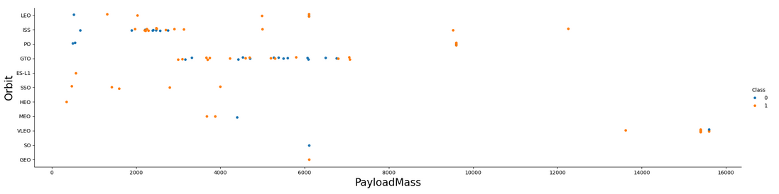
Payload vs. Orbit Type
Insights:
For heavy payloads, there is more successful landing for ISS, PO, and VLEO
Successful and failed landing are mixed for GTO

Slide 23
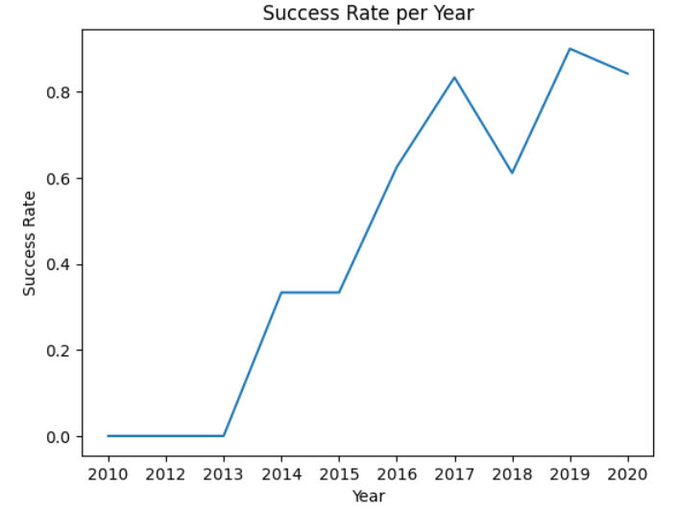
Launch Success Yearly Trend
Insights:
The landing success rate kept increasing since 2013 till 2020

Slide 24
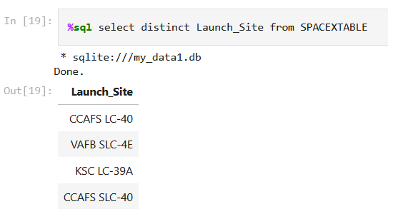
All Launch Site Names
Use of the keyword DISTINCT to return unique Launch Site Name
There is only 4 different launch Site used by SpaceX

Slide 25
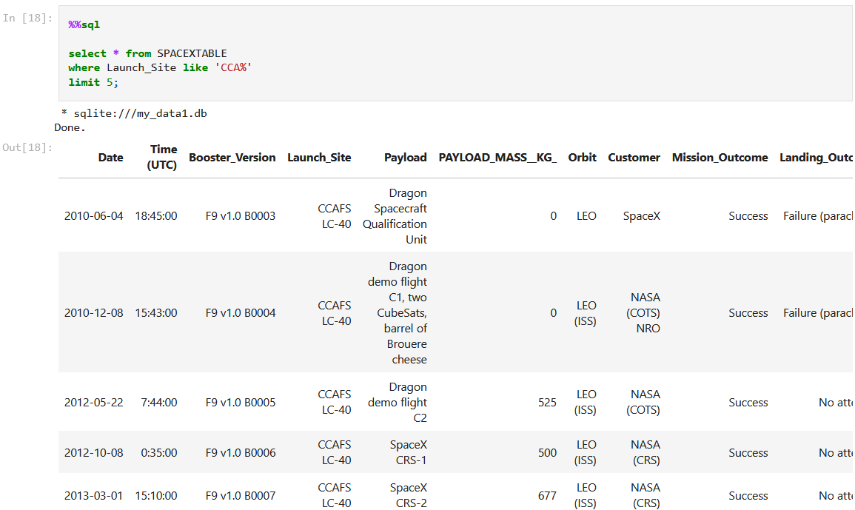
Launch Site Names Begin with 'CCA'
indicates that Launch Site must start with ‘CCA’
restricts the results to 5 records only

Slide 26
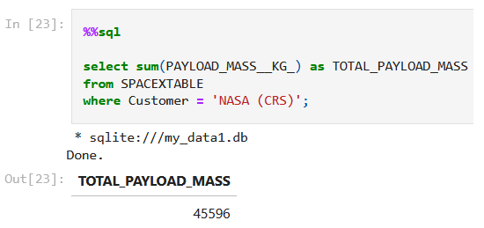
Total Payload Mass
The total payload carried by boosters from NASA is 45596 kg

Slide 27
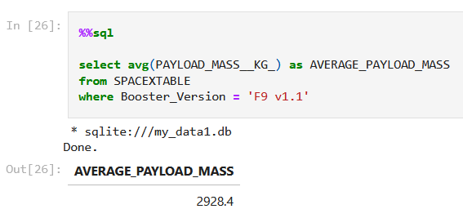
Average Payload Mass by F9 v1.1
Boosters version F9 v1.1 carry in average a payload of 2928.4 kg

Slide 28
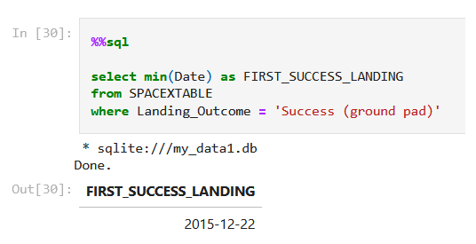
First Successful Ground Landing Date
The first successful Ground Landing was on 22 December 2015

Slide 29
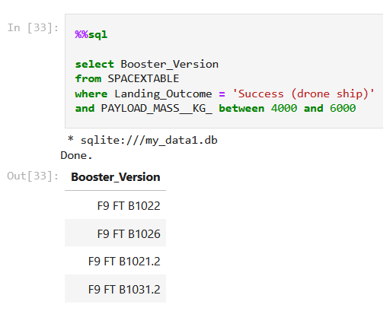
Successful Drone Ship Landing with Payload between 4000 and 6000
There are 4 different booster versions that have successfully landed on drone ship with payload mass greater than 4000 but less than 6000

Slide 30
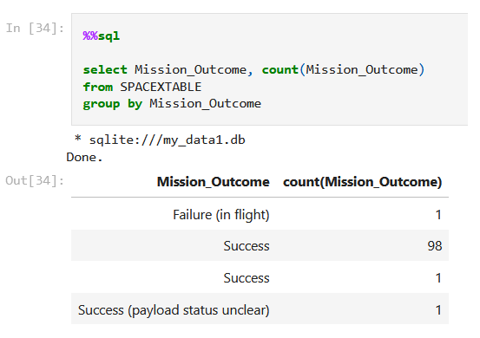
Total Number of Successful and Failure Mission Outcomes
Only 1 Failure Mission Outcome has been found in the dataset

Slide 31
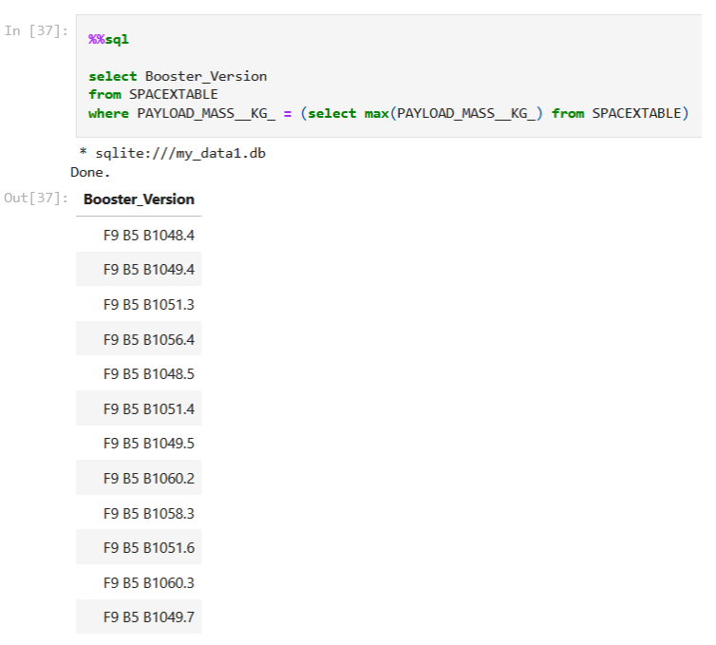
Boosters Carried Maximum Payload
There are 12 different Boosters that carried the maximum payload

Slide 32
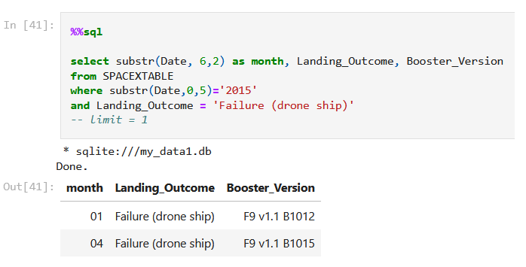
2015 Launch Records
There are 2 failed landing_outcomes on drone ship in year 2015
First was on January and the second in April

Slide 33
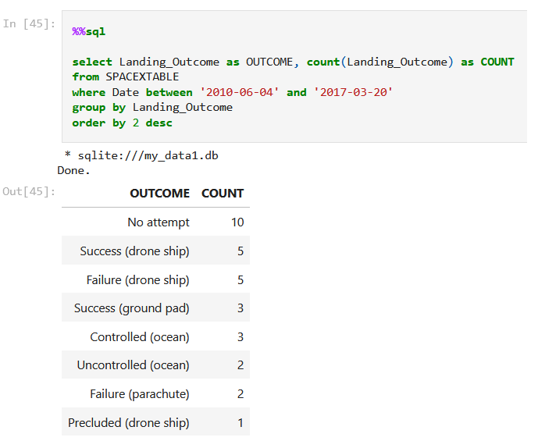
Rank Landing Outcomes Between 2010-06-04 and 2017-03-20
The most frequent outcome is No attempt
The least recurring outcome is Precluded on Drone Ship

Slide 34

Section 3

Slide 35
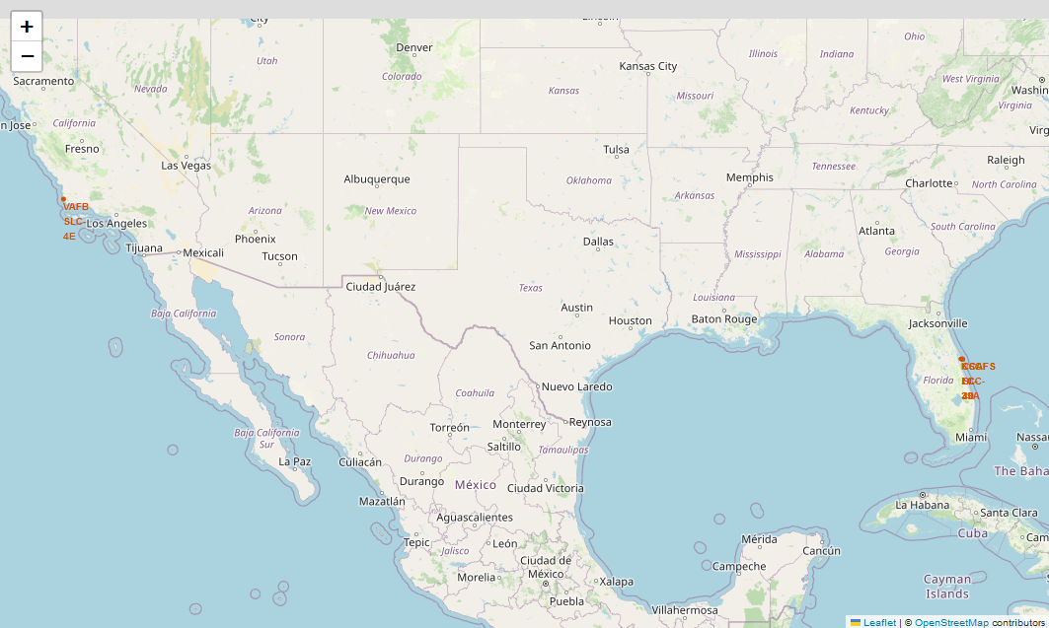
SpaceX Launch Sites
All launch sites are located on American coasts
Only VAFB SLC 4E is located on west coast. All the others are on east coast

Slide 36
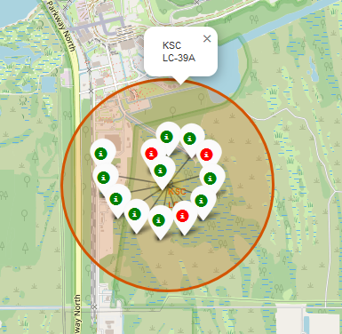
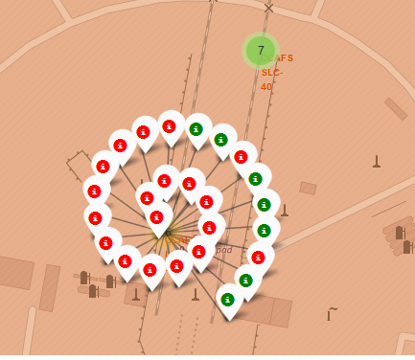
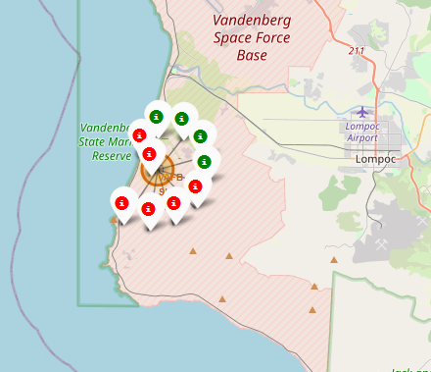
Landing outcome for each Launch Site
A successful landing is represented by a green Icon, And Red Icon for a failure
Launch sites with high success rates can be easily identified

Slide 37
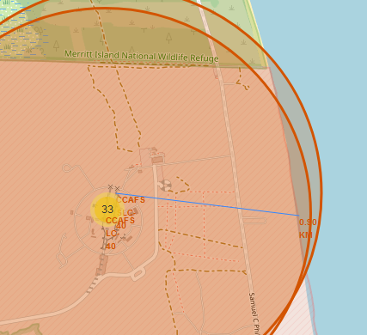
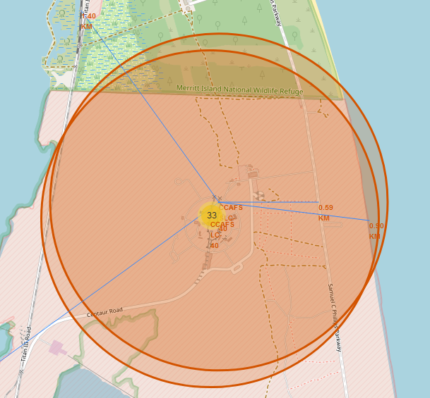
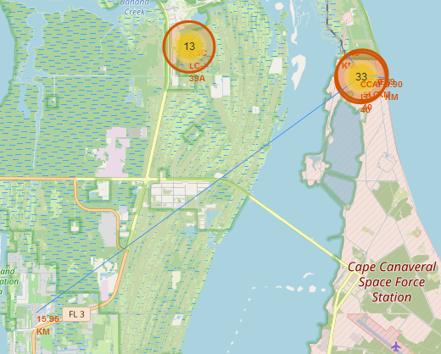
Launch Site Proximities
Space launch sites are located near the equator
Launch sites are in close proximity to railways to facilitate material (heavy cargo) transportation
Launch sites are in close proximity to highways to facilitate people and material transportation
Launch sites are in close proximity to coastline as water is safety buffer in case of launch failure
Launch sites are not in close proximity to cities to ensure the safety of the population

Slide 38

Section 4

Slide 39
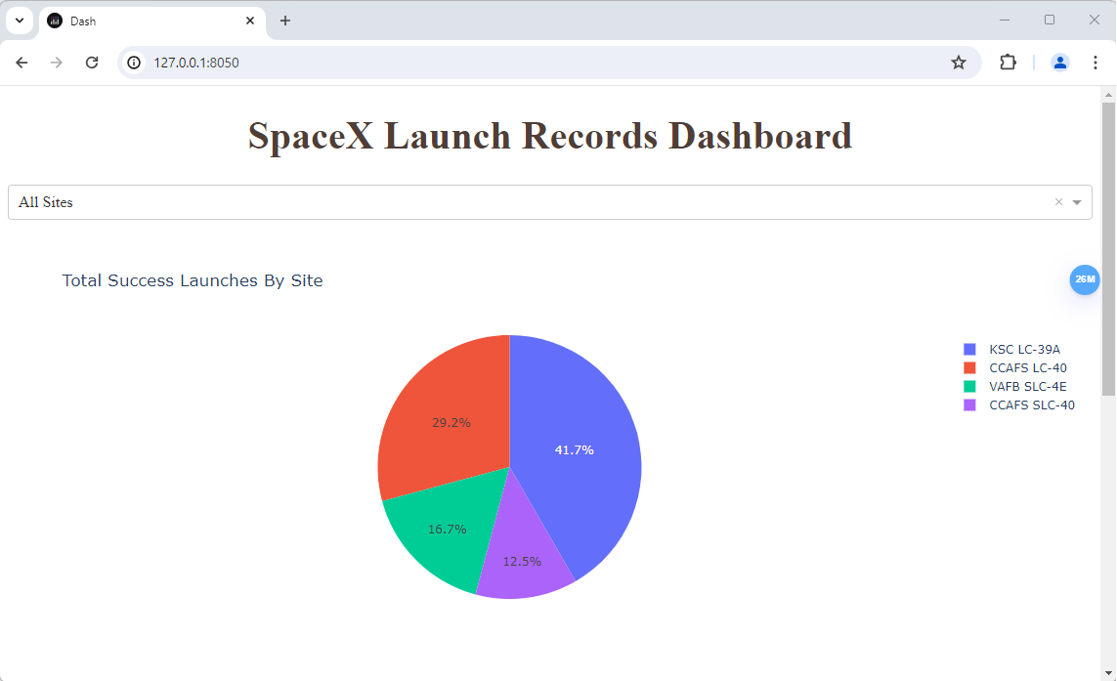
Dashboard – Success Launches by Site
The dropdown list allows to select launch Site
KSC LC-39A has the highest success rate
CCAFS SLC-40 has the lowest success rate

Slide 40
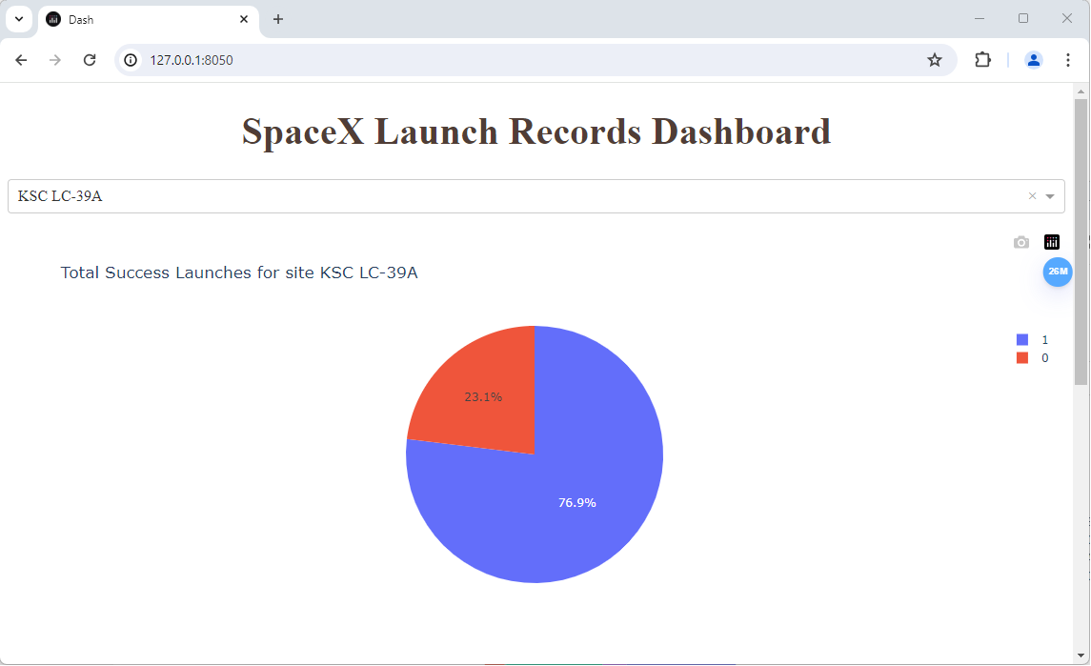
Dashboard - Site with Highest Success Rate
The proportion of success landing for KSC LC-39A is 76.9%
The ratio of failed landing for KSC LC-39A is 23.1%
KSC LC-39A is selected in the dropdown list

Slide 41
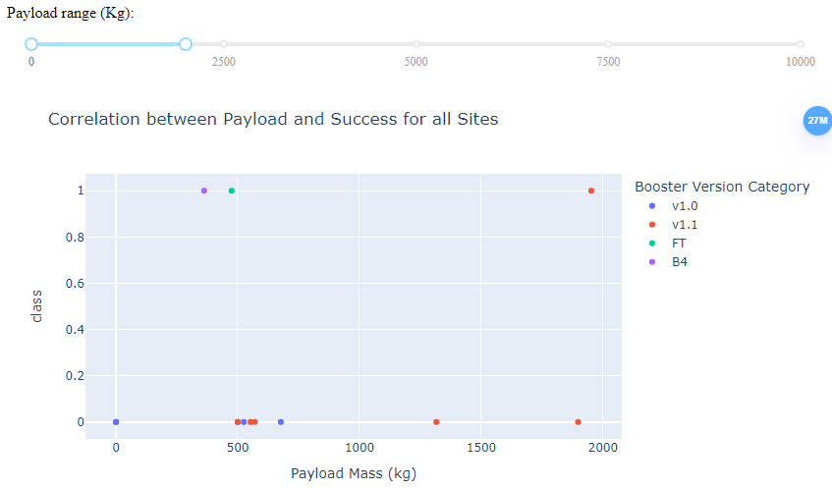
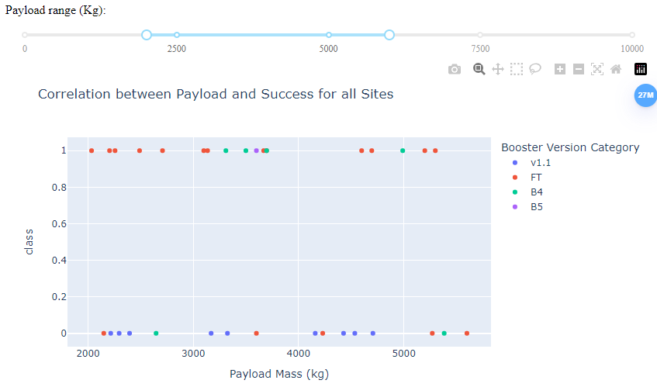
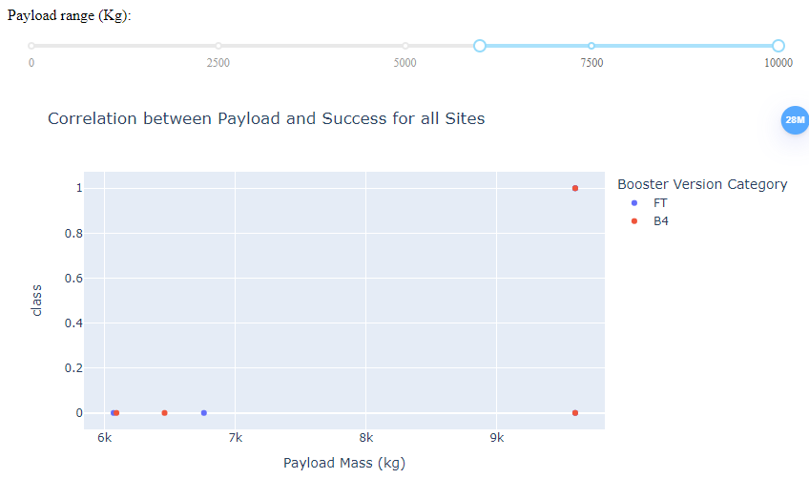
Dashboard – Correlation between Payload and Success
For light payload, the boosters B4, FT and V1.1 provide a better success rate
For medium payload, the boosters B4, FT provide a better results
For heavy payload, only B4 provides a good success rate
The 1st stage has higher chance to land if they carried medium payload

Slide 42

Section 5

Slide 43
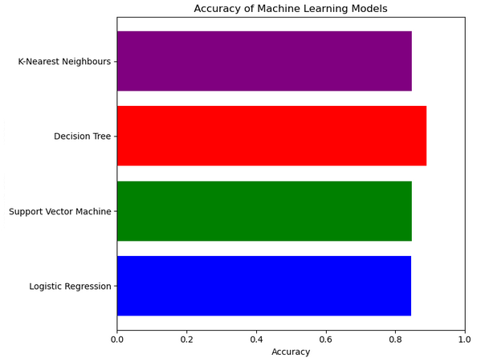
Classification Accuracy
The Decision Tree model has the highest classification accuracy

Slide 44
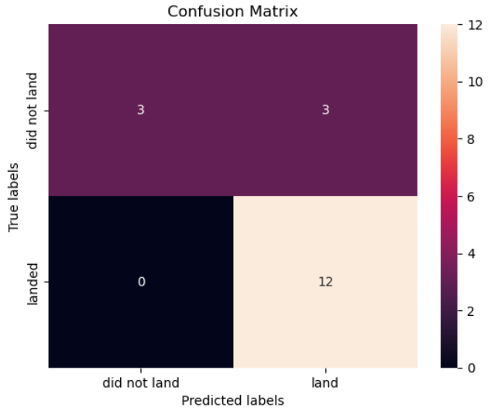
Confusion Matrix
The major problem is false positives
3 unsuccessful landing predicted as successful by the classification model

Slide 45
Conclusions
The success rate kept increasing since 2013 till 2020
Rockets sent to orbits ES-L1, GEO, HEO, SSO and VLEO have high success rate
KSC LC-39A has the highest success rate among launch sites
The booster version B4 provides good results for light, medium, and heavy payloads
The Decision Tree classifier performs slightly better on training set, but all models perform the same on unseen data (test set)
The accuracy of the classification model is 83.33%

Slide 46


